Slide 1
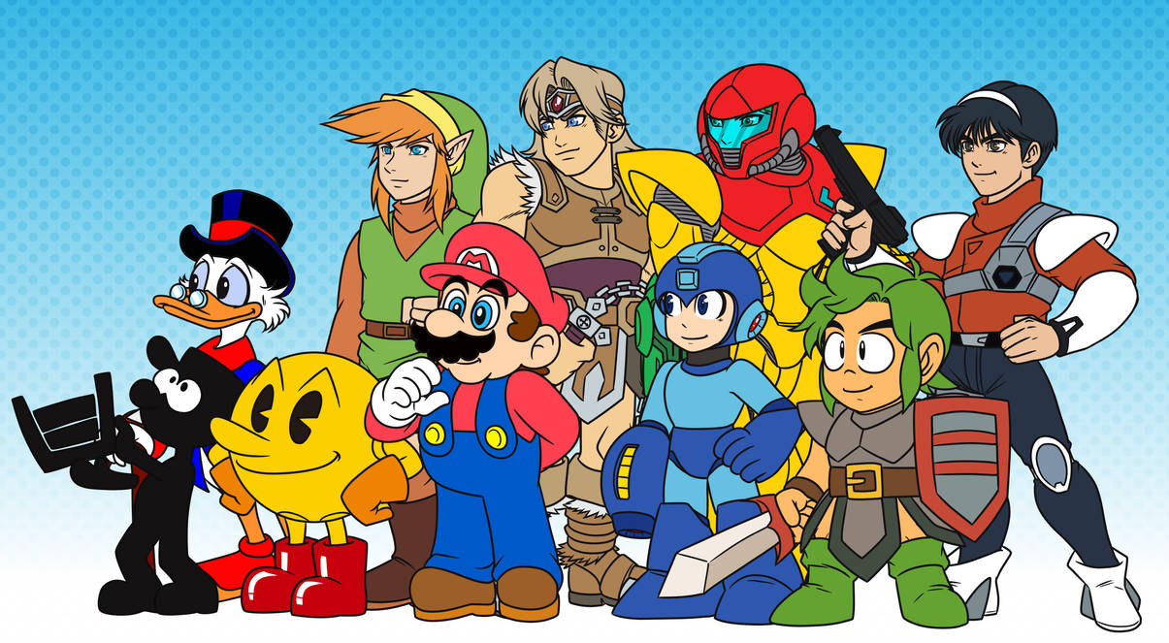
How video games have trended over time…
This Photo by Unknown Author is licensed under CC BY-NC-ND

Slide 2
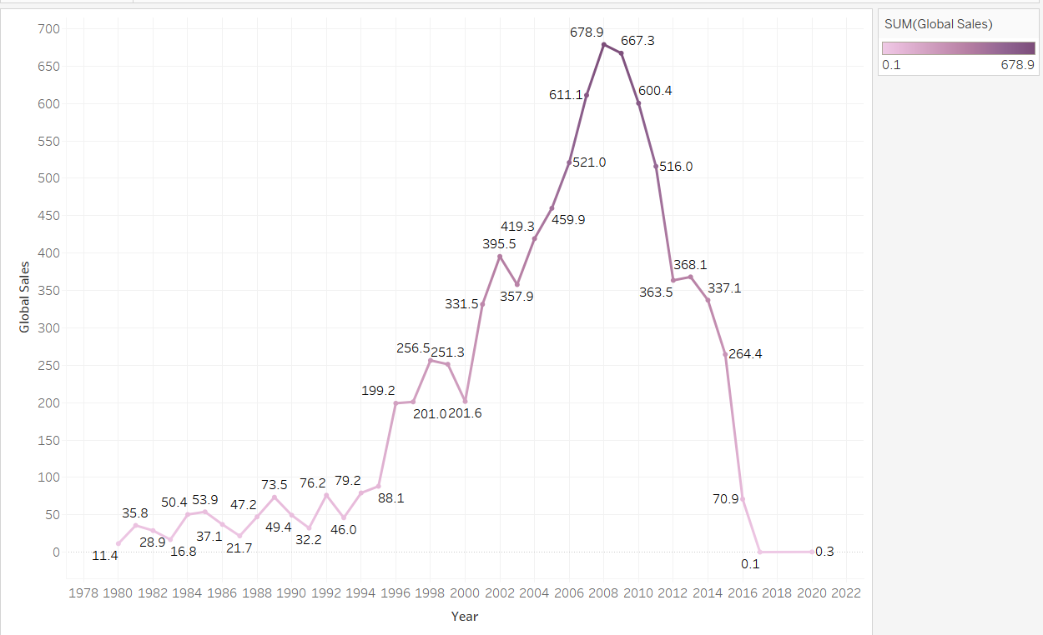
Global Sales of Video Games Over Time
As you can see, global sales of video games has plummeted since 2008

Slide 3

In order to improve our sales we must first see which genre of games and gaming systems are most popular…

Slide 4
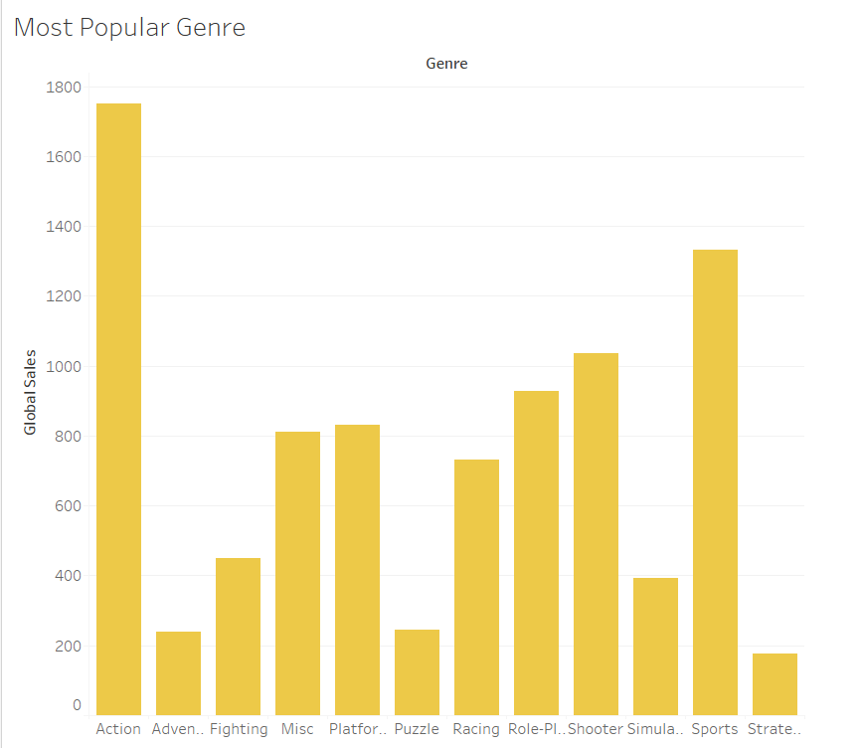
Action video games are by far the most popular
Sports video games come in second place

Slide 5
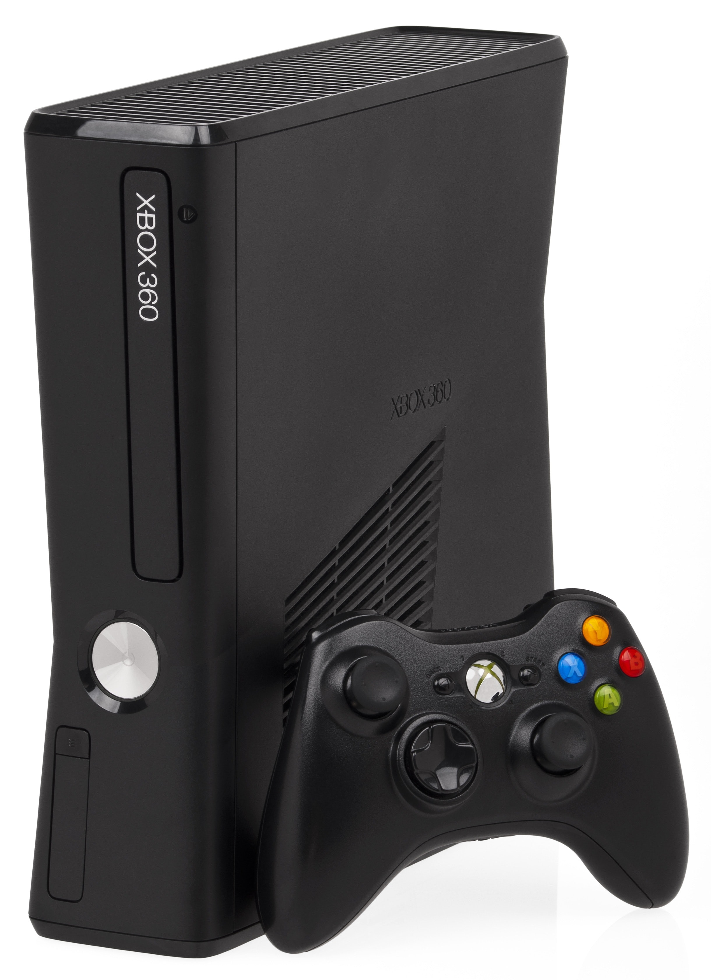
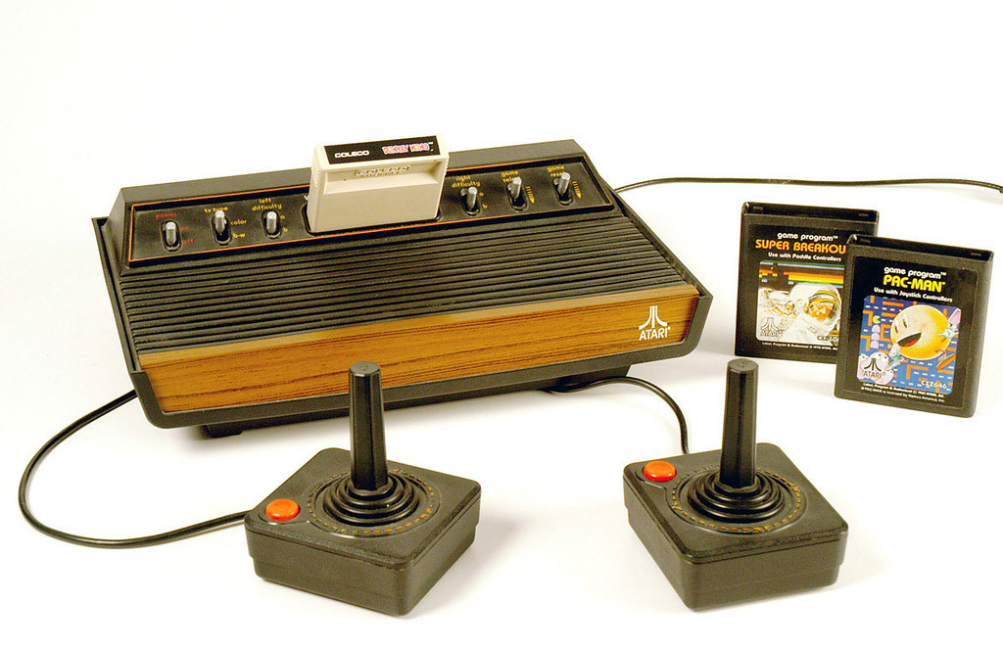
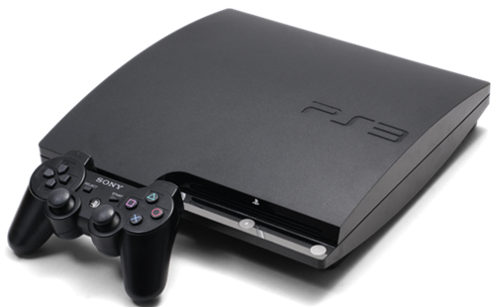
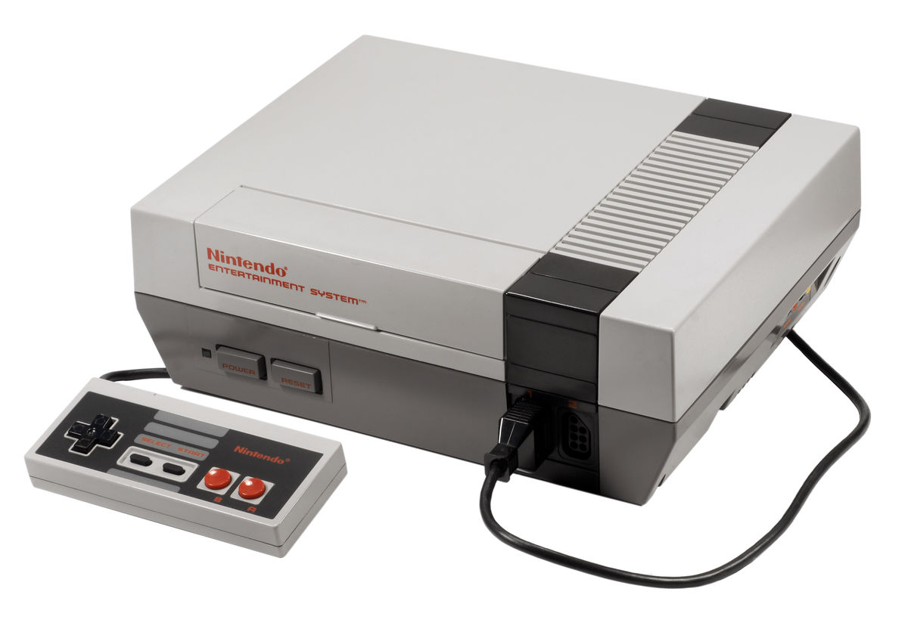
It is also important to sell video games that go with the most popular gaming systems…
This Photo by Unknown Author is licensed under CC BY-NC
This Photo by Unknown Author is licensed under CC BY
This Photo by Unknown Author is licensed under CC BY-SA

Slide 6
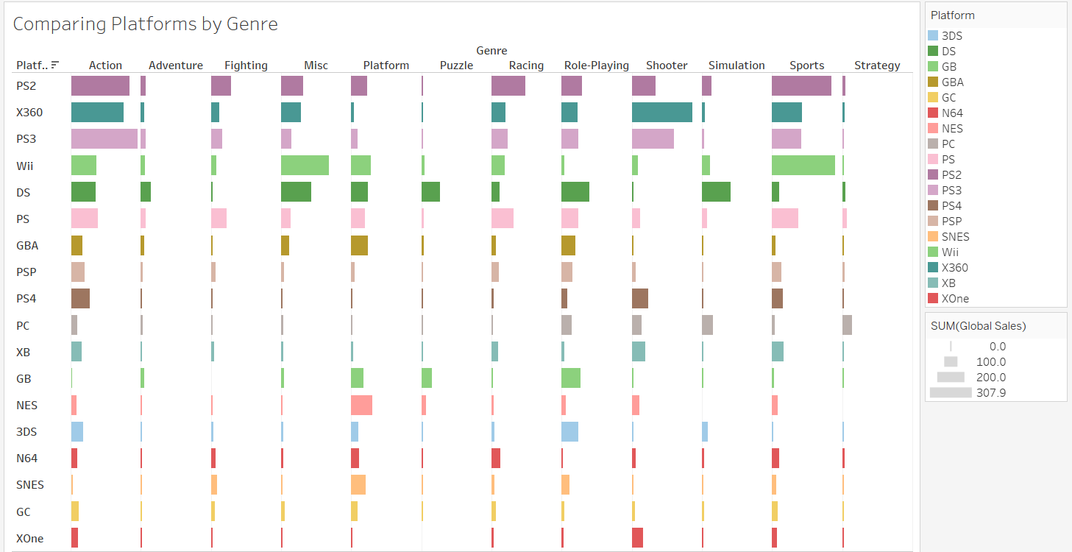
When comparing platforms and genres by sales…
PS2, Xbox 360, PS3, Wii, DS and PS are the most popular

Slide 7
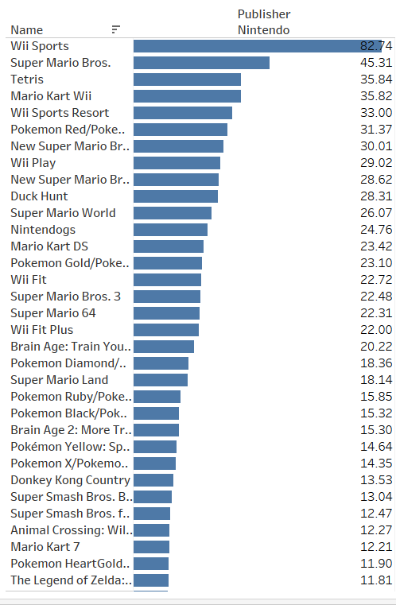

Here is a list of the most popular games by
This Photo by Unknown Author is licensed under CC BY-SA

